Slide 1
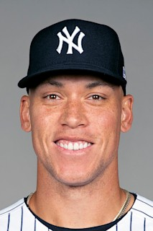

Aaron Judge and His Case as the Lead-Off hitter
Jarrett Markman

Slide 2
How was specific data found?
Baseball Reference has home run data sorted
With the data from Baseball Reference, I was able to clean, analyze, and visualize certain home run data
Disclaimer* - The data set is only all 62 of Judge’s home runs.

Slide 3
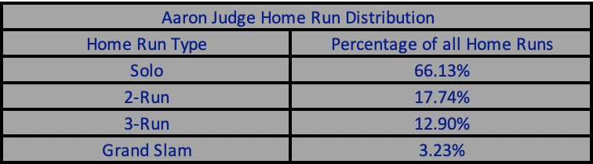

Slide 4
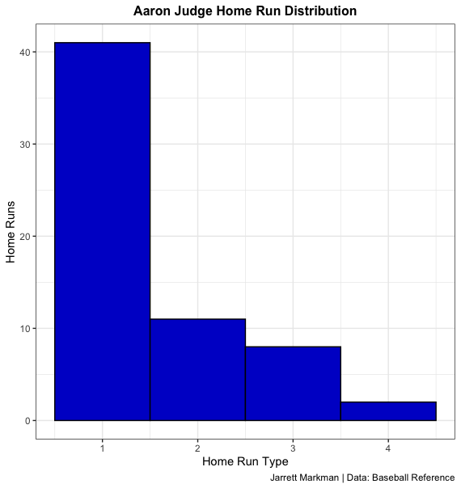
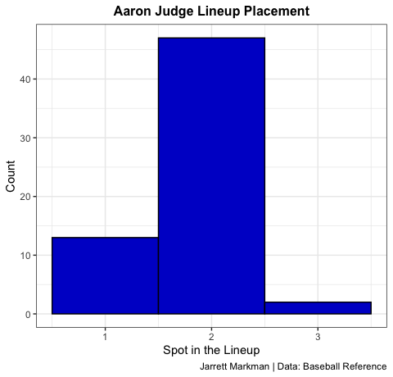
Home run analysis
The distribution is heavily right-skewed.
While it makes a lot of sense for a right-skew due to the fact it’s unlikely to have multiple base runners on for a home run consistently, the skew is very big.
Almost 70% of Judge’s 60 homers were solo home runs, meaning that almost 7 out of every 10 home runs would come with no runners on base.
Roughly 2 of every 10 would be a 2-run home run, and 1 out of every 10 would be a 3-run home run.
It’s very clear that despite not hitting first in the lineup, so many of Judge’s home runs came with no runners on base.

Slide 5
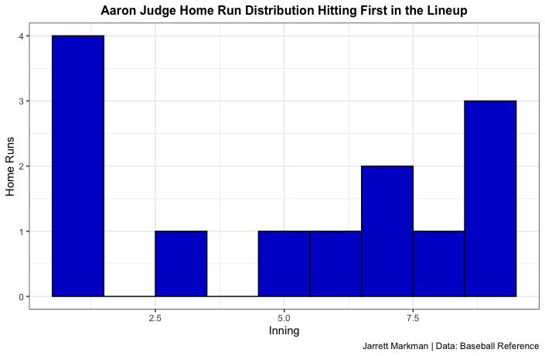
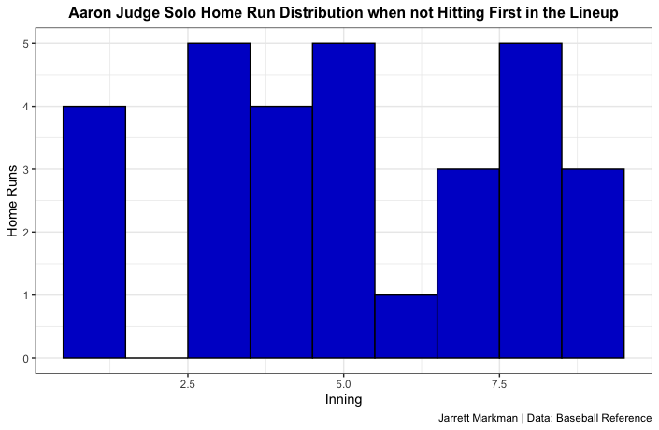
More judge Home Run analysis
Contrary to my initial belief, Judge did have 4 lead-off home runs, which was the most he hit in any inning the leadoff spot.
However, despite not hitting in the leadoff spot, Judge had 4 first inning solo home runs.
Meaning that the leadoff hitter and/or the second hitter failed to get on base for Judge’s home run.
He additionally hit many solo home runs in other innings when not hitting first in the lineup, meaning the hitter(s) in the first or second slot failed consistently failed to get on base for his home runs.

Slide 6
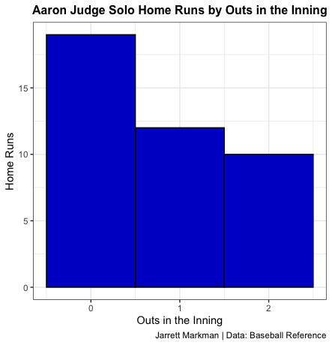
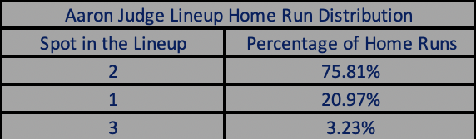
Home Runs by Lineups and outs
For over 75% of his home runs, Judge hit second in the lineup.
Despite this, most often he ended up (by far) hitting his solo home runs with no outs in the inning.
He only hit 12 total home runs as the leadoff hitter (4 of them leading off the game) yet hit well over 15 solo home runs with no outs in the inning.
Hitting him second gave almost no competitive advantage, because despite not being the lead-off hitter in the game, he was still forced into a lead-off role, hitting most of his solo home runs as a lead-off hitter.

Slide 7
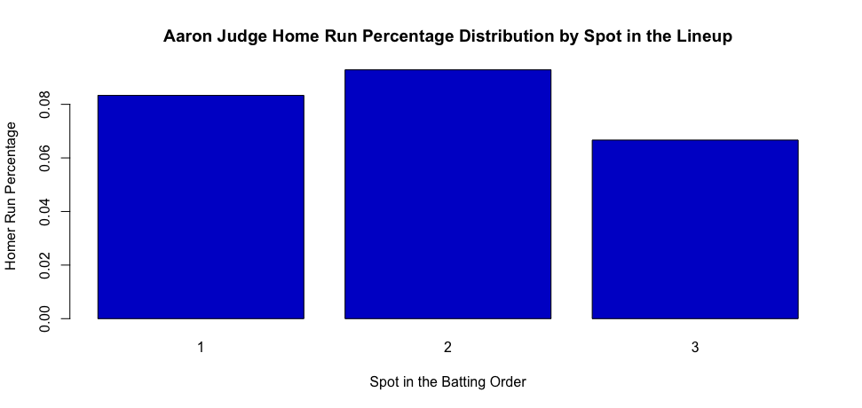

Slide 8
Mathematical analysis (Part I)
Odds of a Judge home run in the 1-spot = .083 or 8.3%
Odds of a Judge home run in the 2-spot = .093 or 9.3%
Odds of a Judge home run in the 3-spot = .067 or 6.7%
Assumptions:
If Judge hits 2nd:
Leadoff hitter has a .350 OBP.
If Judge hits 3rd:
Leadoff hitter and 2nd hitter have .350 OBPs.
If Judge hits 1st:
8th and 9th hitters have .290 OBPs.

Slide 9
Mathematical process
At the 1-spot:
Pr(solo home run) = .083 = 8.3%
Pr(3-run home run) = Pr(8 hitter gets on base) and Pr(9 hitter gets on base) and Pr(Judge home run at 1-spot)
Pr(3-run home run) = .290 x .290 x .083 = .70%
Pr(2-run home run) = Pr(8 hitter gets on base) and Pr(9 hitter does not get on base) and Pr(Judge home run at the 1-spot) or Pr(8 hitter does not get on base) and Pr(9 hitter gets on base) and Pr(Judge home run at the 1-spot)
Pr(2-run home run) = .290 x .710 x .083 x 2(represents both outcomes) = 3.42%
Pr(3-run home run) or Pr(2-run home run) = .70% + 3.42% = 4.12%
At the 2-spot:
Pr(2-run home run) = Pr(1 hitter gets on base) and Pr(Judge home run at 2-spot)
Pr(2-run home run) = .350 x .093 = 3.26%
At the 3-spot:
Pr(3-run home run) = Pr(1 hitter gets on base) and Pr(2 hitter gets on base) and Pr(Judge home run at the 3-spot)
Pr(3-run home run) = .350 x .350 x .067 = .82%
Pr(2-run home run) = Pr(1 hitter gets on base) and Pr(2 hitter does not get on base) and Pr(Judge home run at the 3-spot) or Pr(1 hitter does not get on base) and Pr(2 hitter gets on base) and Pr(Judge home run at the 3-spot)
Pr(2-run home run) = .350 x .650 x .067 x 2(represents both outcomes) = 3.05%
Pr(3-run home run) or Pr(2-run home run) = .82% + 3.05% = 3.87%

Slide 10
Mathematical Analysis (Part II)
At the 2-spot:
The odds he hits a 2-run home run are 3.26%
At the 3-spot:
The odds he hits a 3-run home run are .82%
The odds he hits a 2-run home run are 3.05%
The odds he hits either a 2-run or 3-run home run are 3.87%
At the 1-spot:
The odds he hits a solo, lead-off home run are 8.3%
If the lineup starts an inning 8-9-1:
The odds he hits a 3-run home run are .70%
The odds he hits a 2-run home run are 3.42%
The odds he hits either a 2-run or 3-run home run are 4.12%.

Slide 11
Mathematical Reasoning
The most likely outcome in all these scenarios is that Judge hits a 2-run home run in the 8-9-1 turnover (aside from a solo home run).
Based on how unlikely Judge was to hit a home run in the 3-spot, he is more likely to hit a home run at the 1-spot with the 8 and 9 hitters getting on than hitting a home run at the 3-spot with the 1 and 2 hitters getting on (this is mostly due in part to the fact that the difference in OBP from the “better” hitters, isn’t significantly higher than the OBP for the “worse” hitters).
In addition to that, he’s more likely to get either a 2-run or 3-run home run from 8-9-1 at the 1-spot than he is to get either a 2-run or 3-run home run from 1-2-3 at the 3-spot.
Not to mention that based on the Yankee lineup the OBPs for the top hitters were overestimated and bottom hitters were underestimated.
The nation that a good hitter with power (someone like Judge) should hit later in the lineup for the possibility of a runner on base is ridiculous.
The odds that a runner gets on base and Judge hits a home run are extremely low (less than half as likely as Judge hitting a solo home run).
The marginal benefit of hitting judge more is higher than the extremely low possibility of him hitting a home run with runners on base.

Slide 12
Judge should hit first.
Based on baseball history, Aaron Judge is the prototypical 3-hitter, however, out of all the places he hit in the Yankees lineup that might be the worst possible spot for him.
Despite not being a leadoff hitter, most of the time Aaron Judge’s home runs came with nobody on base (over 66% of his home runs were solo home runs).
Aaron Judge has no effect on whether runners get on base, so it would make a lot of logical sense to hit him first, so he has the best opportunity to hit a home run
If the hitters before him are not extremely likely to get on base, the likelihood that Judge hits a home run in addition to them getting on base is so small compared to the chance that Judge hits a solo home run on his own.
Hitting Judge in the first spot would give the Yankees the chance to hit their best hitter the most and give their best hitter the change to produce the most runs to the best of his ability.
The already unlikely outcome of a runner getting on base for Judge to then hit a home run is not worth sacrificing the very valuable opportunity of getting your best hitter the biggest chance to affect the game.
HIT YOUR BEST HITTER FIRST!

